Slide 1
Jit Team & 3LO 2019-2020
JavaScript( )

Slide 2
JavaScript definition
Language of the web
Dynamically typed
Aside from websites it can be used for servers, mobile applications or even desktop software.
Notes:
Fun fact: Vscode jest napisany w javascripcie; Danger Crew to gra napisana w javascripcie – a dokladnie w react – ktora mozna zainstalowac przez steam ;)

Slide 3
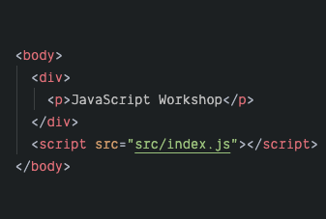
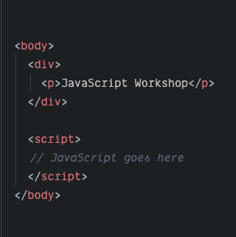
Adding JavaScript to a project

Slide 4
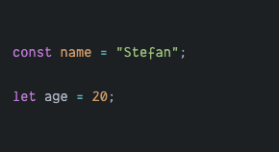
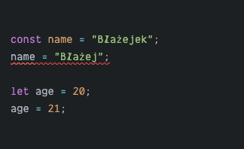
Data declaration and reassignment
const – short for constant – it cannot be reassigned;
let – short for let x be equal y – it can be reassigned;

Slide 5
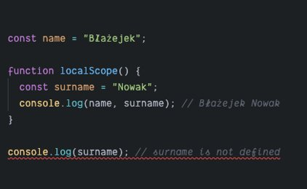
Scope
Both const and let are block-scoped
Block-scope is defined by curly braces {}
Scope works up but not down

Slide 6
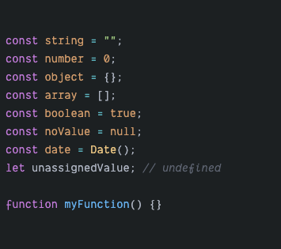
Data types
String
Number
Function
Date
Boolean – true / false
Null – for no value
Undefined – for unassigned values
Object – complex data structures
Array – list of values

Slide 7
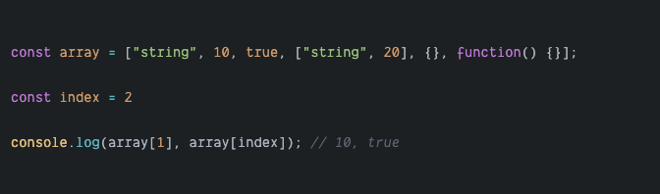
Array
List of values
Represented by 0-based index
Can contain any other type of data including other arrays
Eah value in the array can be accessed via square bracket notation []

Slide 8
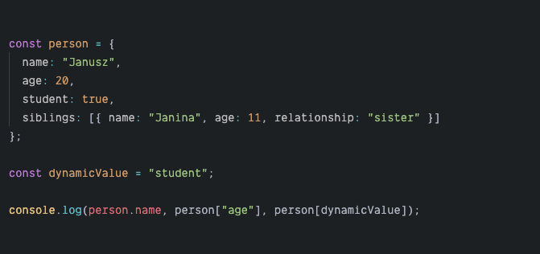
Object
Dataset containing contextual information
Represented as a set of key-value pairs
Can contain any other type of data including other objects
You can access each value using a key and dot or square bracket notation
Notes:
Mozna sie ich zapytac czy ktos ma pomysl jak wyciagnac imie siostry z obiektu ;)

Slide 9
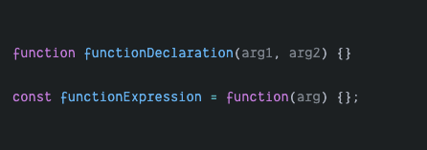
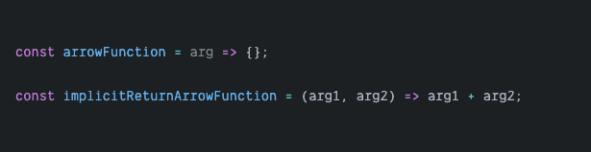
Function
Enables to run a particular block of code on demand
Takes in arguments, does calculations and returns new value – or not
Function declaration vs. Function expression
Arrow function

Slide 10
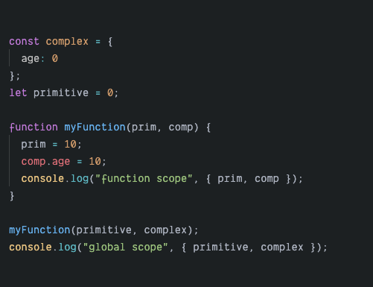
Primitive vs. Complex types
String, number, boolean, null & undefined are primitive
Array, function, object and date are complex
Primitive types are passed by value
Complex types are passed by reference
Notes:
Przekazywanie wartości znaczy, że nowe miejsce w pamięci jest przeznaczone na przekazywaną wartość w efekcie tworząc kopię tej wartości
Przekazywanie referencji oznacza, że odnosimy się do istniejącej wartości w pamięci
Screen console logow na nastepnym slajdzie

Slide 11
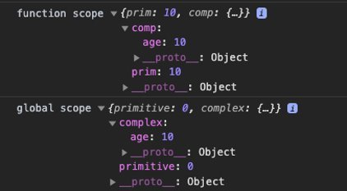

Slide 12
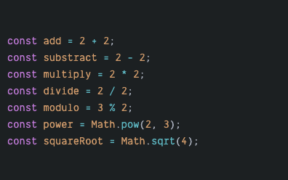
Arythmetic operators

Slide 13
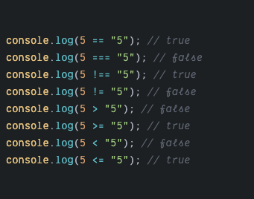
Logic operators

Slide 14
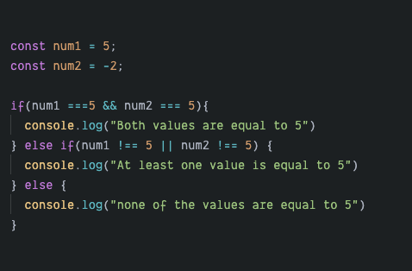
Conditional statements

Slide 15
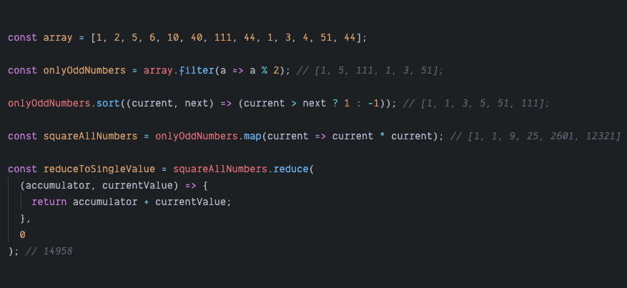
Array methods
Array.prototype.filter
Array.prototype.sort
Array.prototype.map
Array.prototype.reduce

Slide 16
Array exercises
https://github.com/mackankowski/frontend-bootcamp/blob/master/trainings/js/playground/array-exercises.html

Slide 17
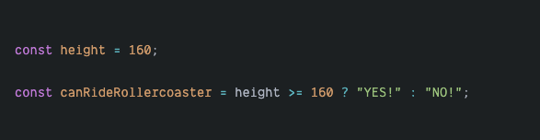
Ternary operator

Slide 18
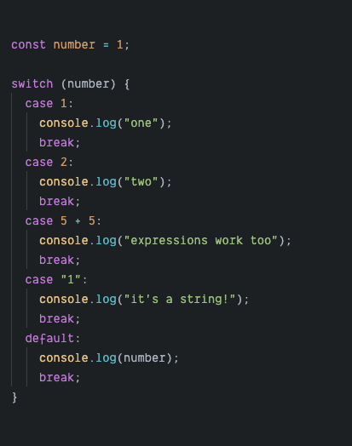
Switch statement

Slide 19
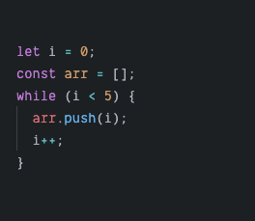
Loops - while
Notes:
Napomknac szybko co ++ znaczy

Slide 20
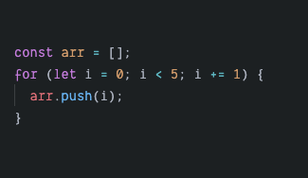
Loops - for
Notes:
"For" sklada sie z trzech czesci, inicjalizacji iteratora, warunku I wyrazenia koncowego
Napomknac szybko o +=

Slide 21
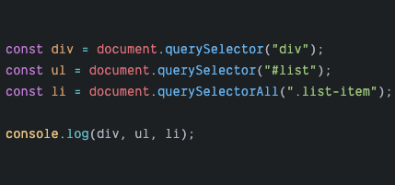
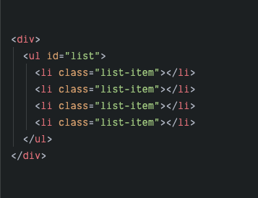
Accessing DOM elements
Notes:
Zwrocić uwage na to ze querySelectorAll wyglada jak array ale jest NodeList
Query selector akceptuje wszystkie selektory css

Slide 22
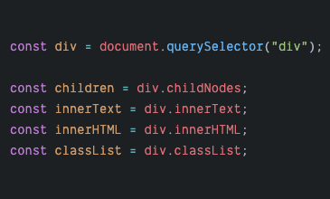
Accessing DOM elements

Slide 23
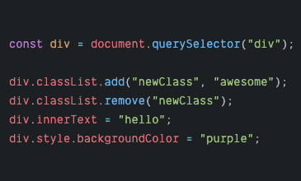
Changing DOM elements

Slide 24
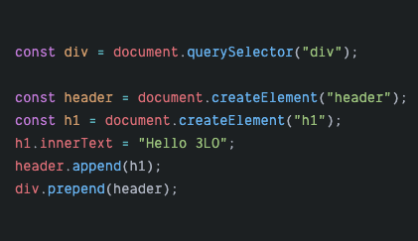
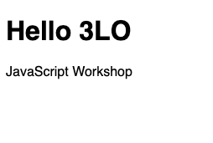
Adding new DOM elements

Slide 25
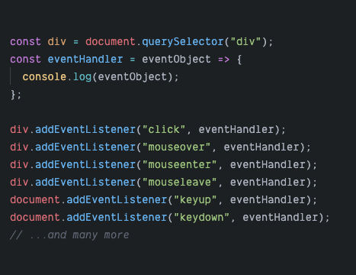
DOM Events

Slide 26
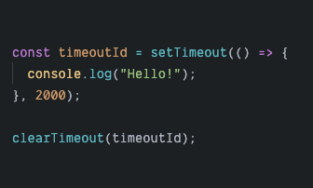
SetTimeout / ClearTimeout
Notes:
Clear timeout rzadko uzywane

Slide 27
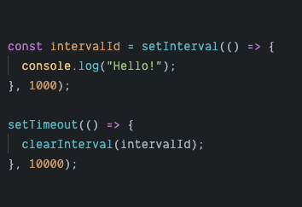
SetInterval / ClearInterval

Slide 28
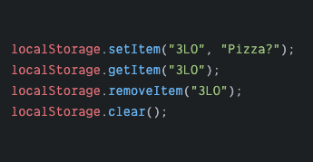
Local storage
Accepts only primitive value types
Browser scoped
Persists through page reloads
Key-value pair based

Slide 29
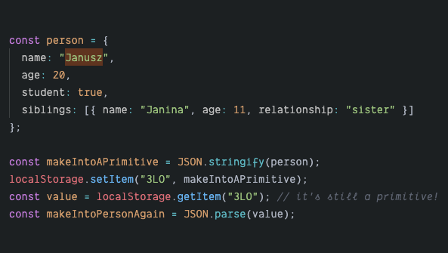
Local storage – what about complex types though?

Slide 30
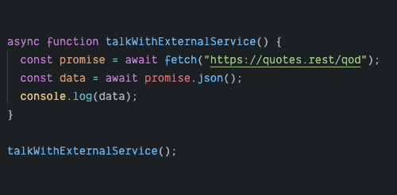
Talking with backend and other services
Fetch API
Promises
Async / await

Slide 31
Workshop #1 random quote generator
A quote is generated on page load
User can click a button to generate a new quote
Style it best you can!
Notes:
Jak bedzie czas to pykne jakies pliki ale to takie latwe jest ze chyba nie trzeba 🤷‍♂️

Slide 32
Workshop #2 stopwatch
User can play, pause and reset the timer
Style it best you can!
Notes:
https://github.com/mackankowski/frontend-bootcamp/tree/master/trainings/js/playground/stopWatch

Slide 33
Workshop #3 todo list
User can add new todos
User can edit existing todos
User can delete a todo
Todos persist through reload – local storage
Style it best you can!
Notes:
https://github.com/mackankowski/frontend-bootcamp/tree/master/trainings/js/playground/toDoList

Slide 34
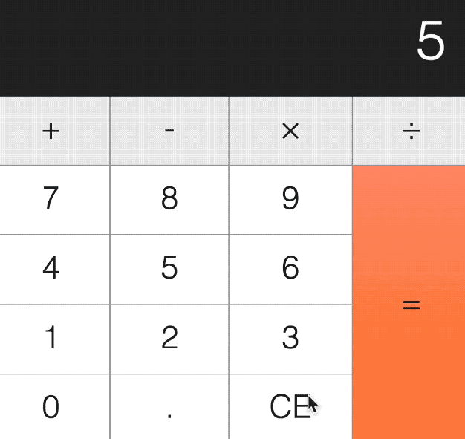
Workshop #4 calculator
Requirements:
Using DOM EventListeners: https://www.w3schools.com/js/js_htmldom_eventlistener.asp
Reponsive layout (flexbox, grid)
Notes:
Homework

Slide 35
Workshop #5 hangman *
Requirements:
Vanilla JS (no libraries and frameworks)
Use predefined dataset: https://github.com/mackankowski/frontend-bootcamp/blob/master/trainings/js/playground/hangman/data.js
Scoreboard in localStorage: https://www.w3schools.com/html/html5_webstorage.asp
Reponsive layout (flexbox, grid)
Notes:
Homework

